Slide 1
EIE 411 COMPUTER ORGANIZATION AND ARCHITECTURE
MODULE 1: INTRODUCTION

Slide 2
Outline for Module 1
Computer Fundamentals:
Development history of computer hardware and software.
Hardwired vs. stored program concept.
Von-Neumann architecture.
Harvard architecture:
i. principle of operation, ii. advantages, iii. disadvantages. Iv. Single address machine. v. Contemporary computers.
Computer system: block diagram, functions, examples, dataflow, control line.

Slide 3
Development history of computer hardware and software.
Computer Generation
Landmark development
Looking into future

Slide 4
Five Generations of Computers
History of computer development divided into 5 generation
Each generation characterized by a major technological development.
Fundamental changes in terms of
Size
Cost
Power
Efficiency
Reliability

Slide 5
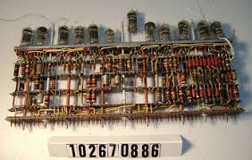
First Generation- 1940’s and 50’s: Vacuum Tubes
Expensive, bulky,
Unreliable, power
Consumer
Used punched
Cards/tapes, magnetic
Drum memories,
Machine language.

Slide 6
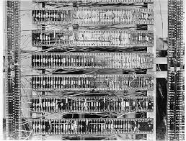
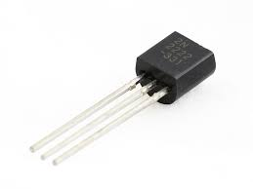
Second Generation- 1950’s and 60’s: Transistors
Smaller, faster,
cheaper, energy-efficient
and more reliable as
compared to vacuum
tubes
Assembly languages,
Early versions of
FORTRAN and
COBOL

Slide 7
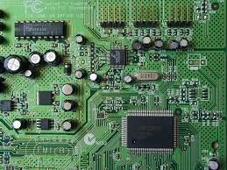
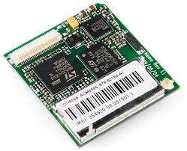
Third Generation -1960’s and 70’s: Integrated Circuits
SSI, MSI, LSI
Speed and efficiency
drastically increased
Keyboards and monitors
Operating systems

Slide 8
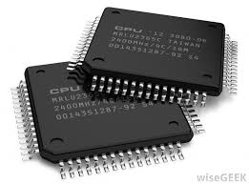
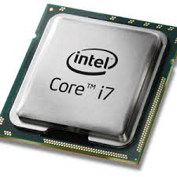
Fourth Generation- 1970’s to Present: Microprocessor
LSI and VLSI
Made home
Computing and
Embedded
Computing possible
Graphics and
Mouse
Hand held devices

Slide 9
Fifth Generation – Present and Beyond: Artificial Intelligence
Voice input//output
Natural language input/output
Parallel computing

Slide 10
Relative performance per unit cost
Year | Technology | Performance/cost
1951 | Vacuum tube | 1
1965 | Transistor | 35
1975 | Integrated circuit | 900
1995 | VLSI | 2,400,000

Slide 11
COMPUTERS SYSTEMS REVIEW
Personal Computers
Enterprise server machines
‘Post-PC’ Devices – Smartphones, tablets, wearables
Application-specific computers – game consoles, etc
Embedded systems/microcontrollers

Slide 12
BASIC FUNCTIONS OF A COMPUTER
Data processing
The primary function of most computers
Data storage
Data movement
i/o operations
data communication
Control
The primary function of microcontrollers, etc.

Slide 13
BASIC COMPONENTS OF A COMPUTER
ALU
for data processing
Control Unit
for control
Memory –
for data storage
I/O
for data movement
The fifth element is the system bus that interconnects the CPU, memory and I/O.

Slide 14
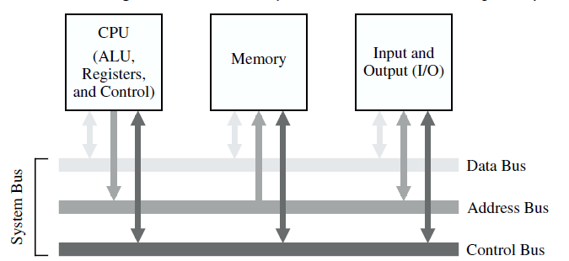
THE BUS MODEL OF A COMPUTER SYSTEM

Slide 15
COMPUTER ORGANIZATION (Summary)
The components from which computers are built of, is computer organization.
Examine the numbers of brick and other building materials

Slide 16
COMPUTER ORGANIZATION
refers to the operational units and their interconnection that realize the architectural specification.
It includes those hardware details transparent to ( i.e. not seen by)the programmer, such as control signals, circuits design, memory and their types, microprocessor design etc.

Slide 17
COMPUTER ARCHITECTURE (summary)
The science of integrating these components to achieve a level of functionalities and performance.
Design 1. Structure 2. Functions.
Structure: The way in which the components are interrelated
Functions: The operation of each individual components as part of the structure.

Slide 18
COMPUTER ARCHITECTURE
describes the capabilities and programming model of a computer.
refers to those attributes of a system that are visible to a programmer or have direct impact on the logical execution of a program.
includes instruction formats, instruction set, addressing modes and data types supported. It describes what the computer does.

Slide 19
WHY STUDY COMPUTER ORG & ARC
key to understanding
hardware and processor design,
compilers, operating systems, and high performance programming.

Slide 20
THE HIERARCHICAL MODEL OF THE COMPUTER
Top
User Level: Application Programs
High Level Languages
Assembly Language / Machine Codes
Microprogrammed/hardwired control
Functional Units (Memory, ALU etc)
Logic Gates
Transistors and Wires
Bottom
Notes:
The computer is a complex system modeled in hierarchical levels from the highest “user” level to the lowest, transistor level. Each of these levels represents an abstraction of the computer; and these levels of abstraction are separate, or independent from one another. For example, a user who runs a word processing program on a computer needs to know nothing about its programming. Likewise a programmer need not be concerned with the logic gate structure inside the computer.
The hierarchical nature of the computer is essential to both its design and description. The designer need only deal with a particular level of the system at a time. At each level, the system consists of a set of components and their interrelationships. The behavior at each level depends only on a simplified, abstracted model of the system at the next lower level. At each level, the designer is concerned with structure (the way the components are interrelated) and function (how the components operate).

Slide 21
EARLY COMPUTERS
Large mainframes and minicomputers
mainly used by scientific research institutions, government and large corporations.
Programming skills needed to operate them

Slide 22
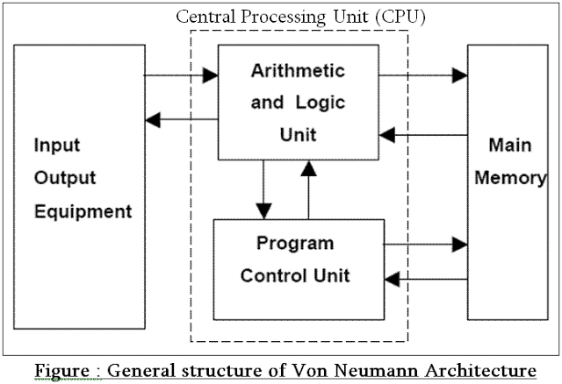
VON NEUMANN MODEL

Slide 23
VON NEUMANN MODEL
.The Von Neumann Architecture is characterized by: -
A memory, arithmetical-logical unit (ALU), control unit, input and output devices,
All parts of a computer are connected together by Bus,
Data can pass through bus in half duplex mode to and from CPU.

Slide 24
VON NEUMANN MODEL
Same memory holds data, instructions
A single set of address/data buses and address space between CPU and memory

Slide 25
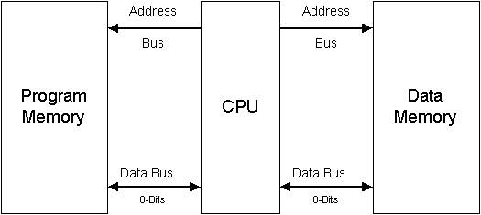
HARVARD MODEL

Slide 26
HARVARD MODEL
Separate memories for data and instructions.
Two sets of address/data buses and address spaces between CPU and memory

Slide 27
HARVARD VS VON NEUMANN
Harvard
Von Neumann
Two memories with two Buses allow parallel access to data access and instructions separately.
More hardware or separate data and address bus for each memory
Requires more space
It has common data and program memory
Requires less hardware as requires only one data and address bus.
Requires less space

Slide 28
HARVARD VS VON NEUMANN
Harvard
Von Neumann
Control unit for two buses is more complicated
Processor can fetch data and instruction simultaneously
More expensive.
Both memories can use different sizes.
One bus is simpler for the control unit design
Only either data or instruction can be fetched at a time.
Computer with one bus is cheaper.
Both memories used same size.

Slide 29
HARVARD VS VON NEUMANN cont’d
Harvard
Von Neumann
Development of the Control Unit is cheaper and faster.
The speed of execution is slow
Data and instruction is accessed in the same way.
Memory size for data and instruction can be adjusted or interchanged
Development of a complicated Control Unit needs more time.
The speed of execution is high
Free data memory can’t be used for instruction and vice-versa.

Slide 30
HARVARD VS VON NEUMANN cont’d
Harvard architecture is used primary for small embedded computers and signal processing (DSP).
Von Neumann is better for desktop computers, laptops, workstations and high performance computers.

Slide 31
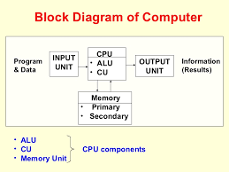

Slide 32
Reference
Okokpujie K. Lecture Notes EIE411, 2016

